Slide 1








Cyber Security
DU # 2101CS632
PRACTICAL - 1
PERFORM VARIOUS COMMANDS IN LINUX
Anindya Sinha
Cyber Security Analyst
Samatrix Consulting Private Limited
anindya.sinha@samatrix.io
9952061704

Slide 2

Download & Install Kali & VMware
First Download & Install VMware Workstation.
Download KALI iso file latest version.
Anindya Sinha
#2101CS632  Practical 1 – PERFORM VARIOUS COMMANDS IN LINUX
‹#›

Slide 3
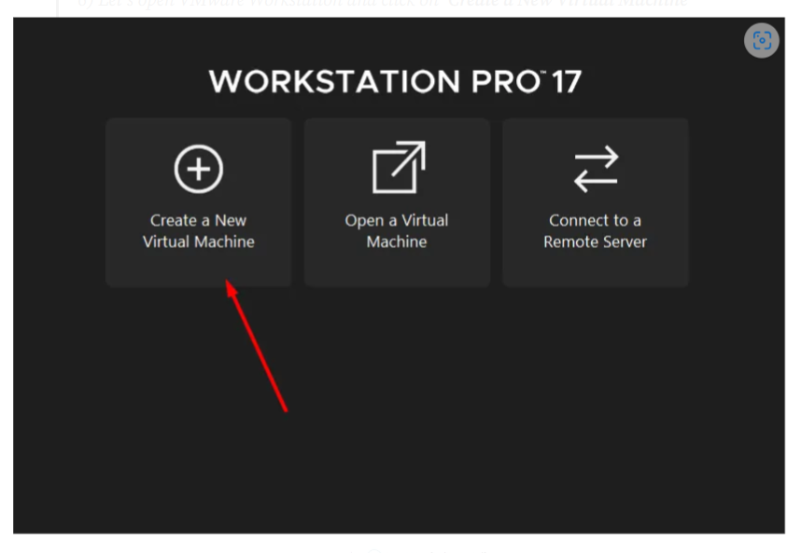
Setting up Kali in VMware
Let’s open VMware Workstation and click on ‘Create a New Virtual Machine’ option.
Anindya Sinha
#2101CS632  Practical 1 – PERFORM VARIOUS COMMANDS IN LINUX
‹#›

Slide 4
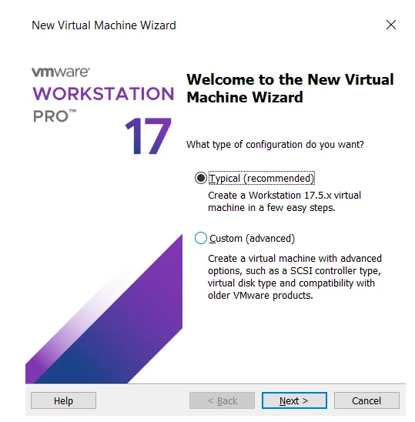
Setting up Kali in VMware
If you are a new user, I recommend selecting the first option, which is ‘Typical (Recommended),’ in the first tab that appears and proceeding with the setup.
Anindya Sinha
#2101CS632  Practical 1 – PERFORM VARIOUS COMMANDS IN LINUX
‹#›

Slide 5
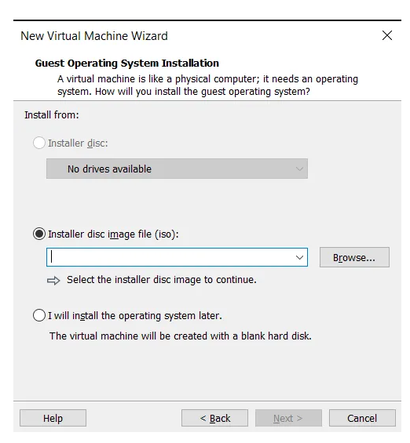
Setting up Kali in VMware
Afterward, choose the Kali Linux ISO file you have installed and proceed
Anindya Sinha
#2101CS632  Practical 1 – PERFORM VARIOUS COMMANDS IN LINUX
‹#›

Slide 6
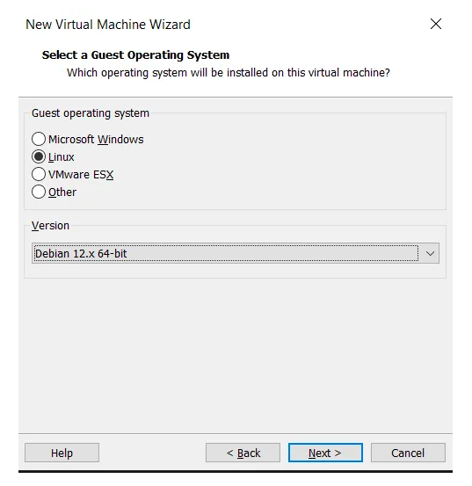
Setting up Kali in VMware
You choose ‘Linux’ for the operating system and select the version as Debian 12.x 64-bit.
Anindya Sinha
#2101CS632  Practical 1 – PERFORM VARIOUS COMMANDS IN LINUX
‹#›

Slide 7
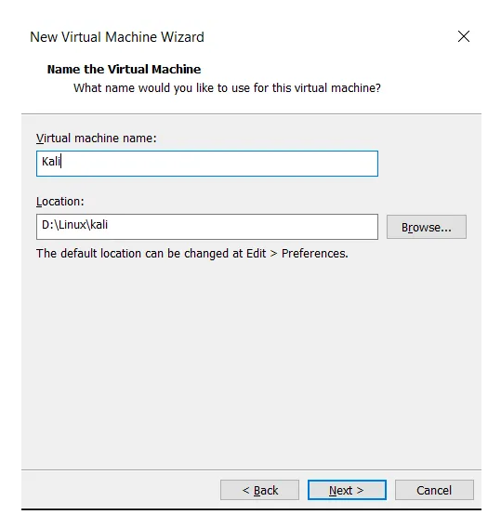
Setting up Kali in VMware
At this stage, you can choose the name for your virtual machine and the desired path for installation.
Anindya Sinha
#2101CS632  Practical 1 – PERFORM VARIOUS COMMANDS IN LINUX
‹#›

Slide 8
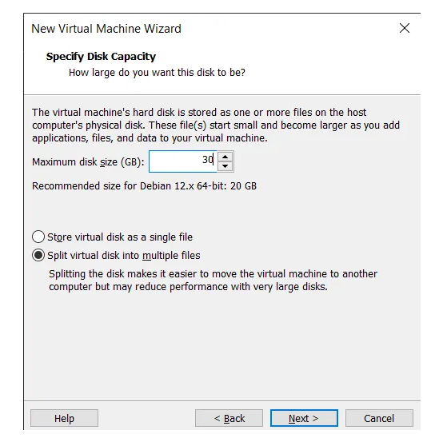
Setting up Kali in VMware
You are determining the allocated space on your disk for Kali Linux. I recommend allocating a minimum of 30 GB.
Anindya Sinha
#2101CS632  Practical 1 – PERFORM VARIOUS COMMANDS IN LINUX
‹#›

Slide 9
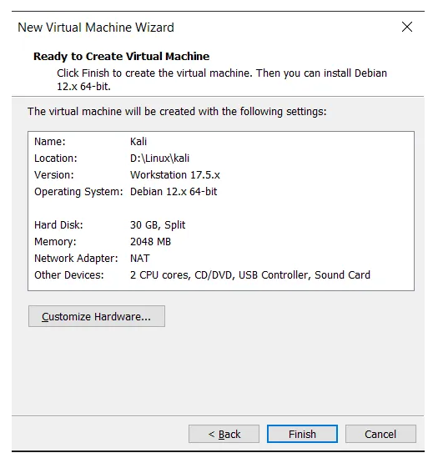
Setting up Kali in VMware
And finally, depending on the hardware power of your computer, you can adjust settings in this section. I recommend allocating a minimum of 4 GB of RAM to Kali Linux.
Anindya Sinha
#2101CS632  Practical 1 – PERFORM VARIOUS COMMANDS IN LINUX
‹#›

Slide 10
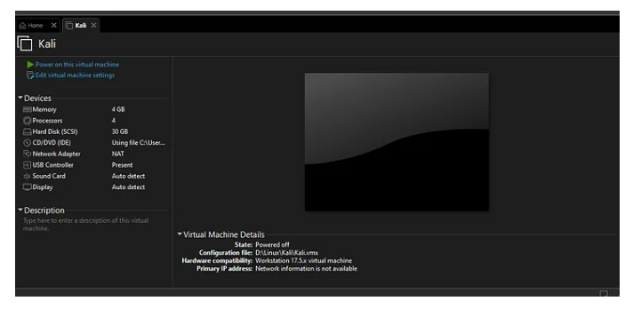
Setting up Kali in VMware
After configuring the hardware settings, you should see a screen similar to the one below. Click on ‘Power on this virtual machine’ to start Kali Linux.
Anindya Sinha
#2101CS632  Practical 1 – PERFORM VARIOUS COMMANDS IN LINUX
‹#›

Slide 11
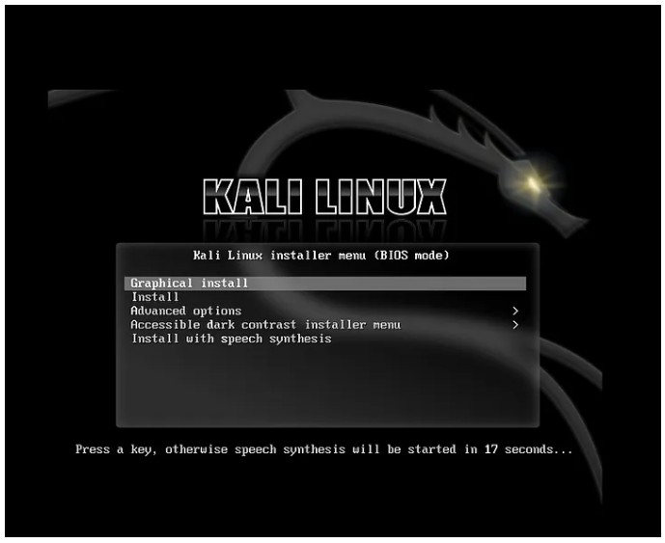
Setting up Kali in VMware
On the initial screen, proceed by clicking on the ‘Graphical Install’ option.
Anindya Sinha
#2101CS632  Practical 1 – PERFORM VARIOUS COMMANDS IN LINUX
‹#›

Slide 12
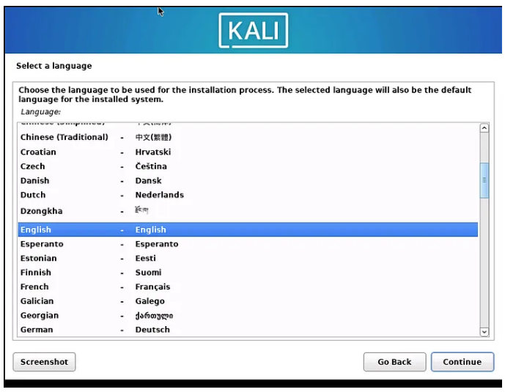
Setting up Kali in VMware
Choose the desired language for Kali Linux in this section.
Anindya Sinha
#2101CS632  Practical 1 – PERFORM VARIOUS COMMANDS IN LINUX
‹#›

Slide 13
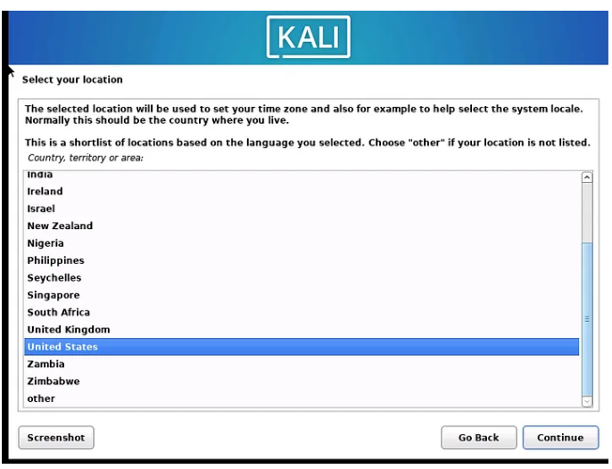
Setting up Kali in VMware
In this section, you can select your location
Anindya Sinha
#2101CS632  Practical 1 – PERFORM VARIOUS COMMANDS IN LINUX
‹#›

Slide 14
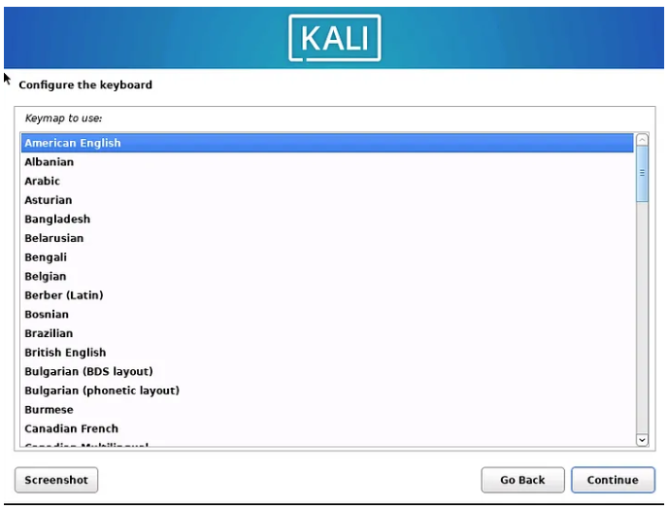
Setting up Kali in VMware
And select your keyboard.
Anindya Sinha
#2101CS632  Practical 1 – PERFORM VARIOUS COMMANDS IN LINUX
‹#›

Slide 15
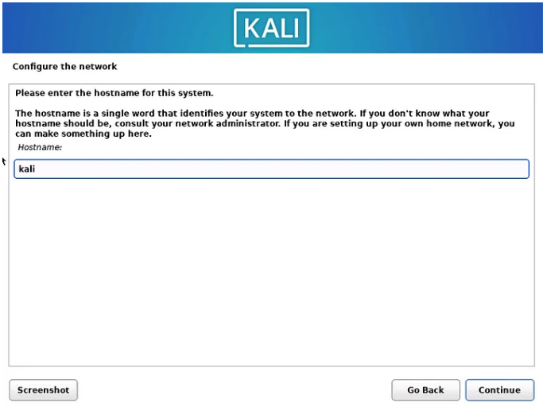
Setting up Kali in VMware
Specify the desired hostname.
Anindya Sinha
#2101CS632  Practical 1 – PERFORM VARIOUS COMMANDS IN LINUX
‹#›

Slide 16
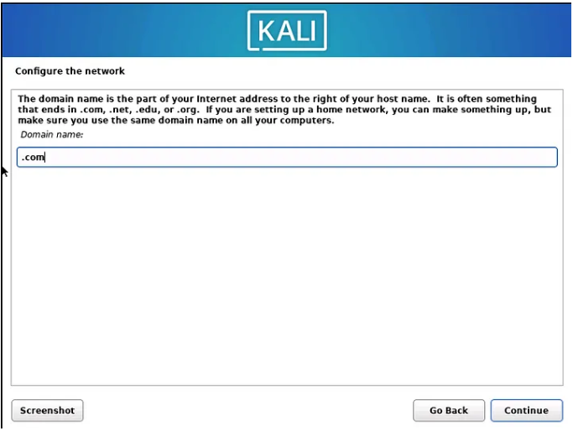
Setting up Kali in VMware
Specify the desired domain name you want to use.
Anindya Sinha
#2101CS632  Practical 1 – PERFORM VARIOUS COMMANDS IN LINUX
‹#›

Slide 17
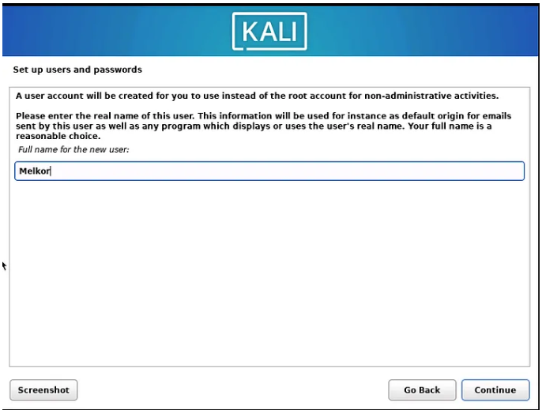
Setting up Kali in VMware
Set your username and, subsequently, your password.
Anindya Sinha
#2101CS632  Practical 1 – PERFORM VARIOUS COMMANDS IN LINUX
‹#›

Slide 18
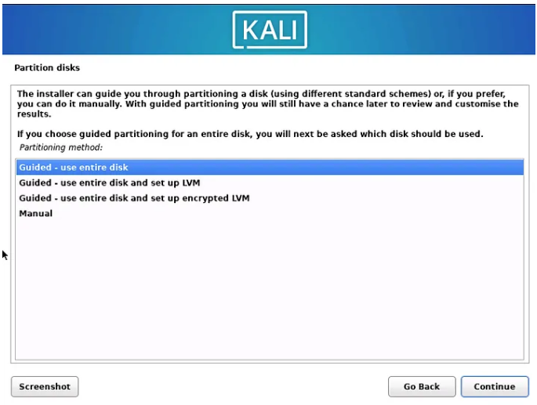
Setting up Kali in VMware
Now, use the entire disk for partitioning
Anindya Sinha
#2101CS632  Practical 1 – PERFORM VARIOUS COMMANDS IN LINUX
‹#›

Slide 19
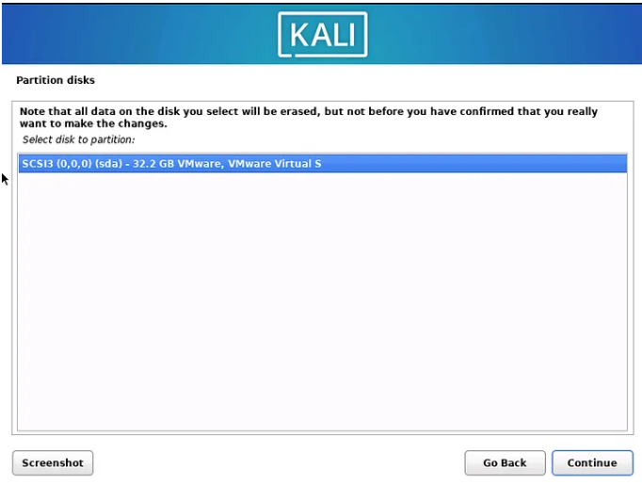
Setting up Kali in VMware
Select your virtual disk
Anindya Sinha
#2101CS632  Practical 1 – PERFORM VARIOUS COMMANDS IN LINUX
‹#›

Slide 20
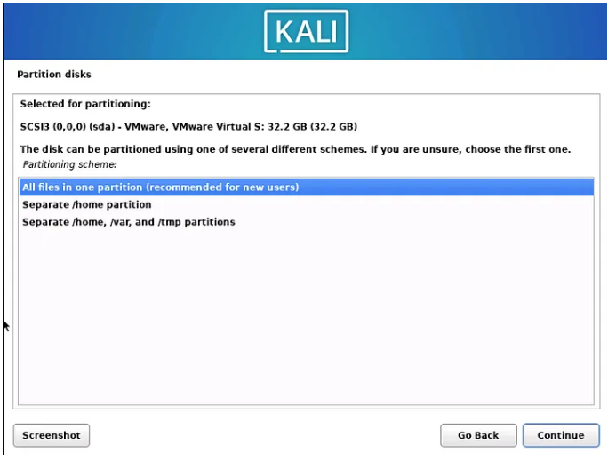
Setting up Kali in VMware
And here, choose the first option.
Anindya Sinha
#2101CS632  Practical 1 – PERFORM VARIOUS COMMANDS IN LINUX
‹#›

Slide 21
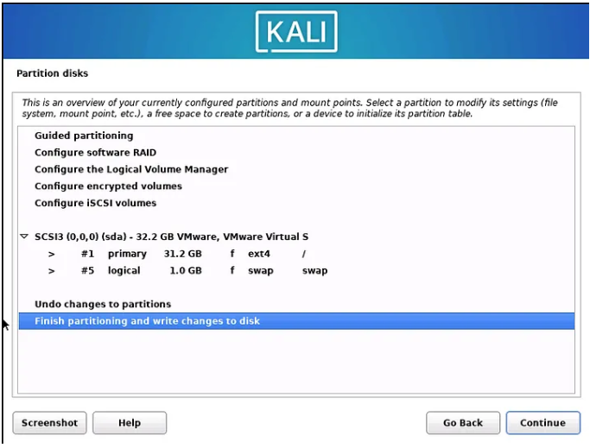
Setting up Kali in VMware
Select Finish partitioning and write changes to disk and continue.
Anindya Sinha
#2101CS632  Practical 1 – PERFORM VARIOUS COMMANDS IN LINUX
‹#›

Slide 22
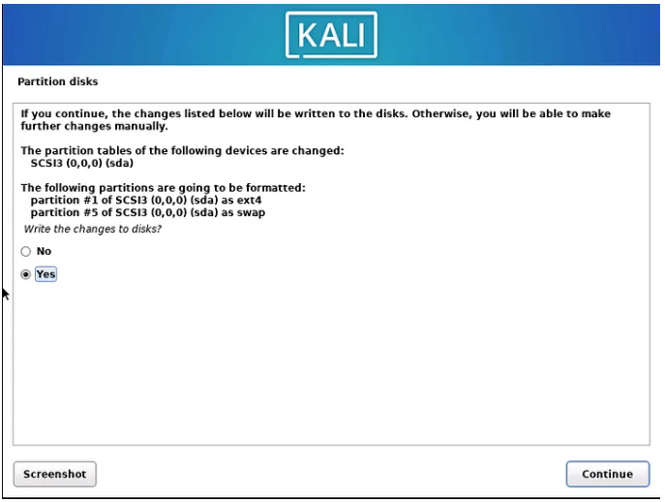
Setting up Kali in VMware
Select ‘Yes’ and continue.
Anindya Sinha
#2101CS632  Practical 1 – PERFORM VARIOUS COMMANDS IN LINUX
‹#›

Slide 23
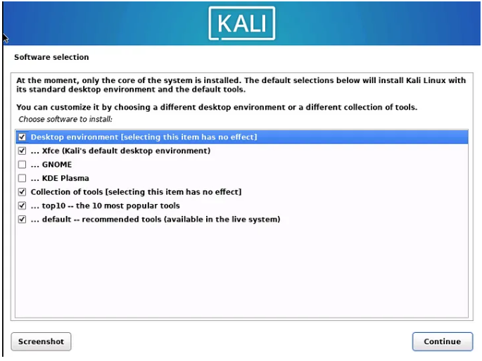
Setting up Kali in VMware
Now you can choose the desktop environment for your Kali Linux. I am using XFCE, so I will select that.
Anindya Sinha
#2101CS632  Practical 1 – PERFORM VARIOUS COMMANDS IN LINUX
‹#›

Slide 24
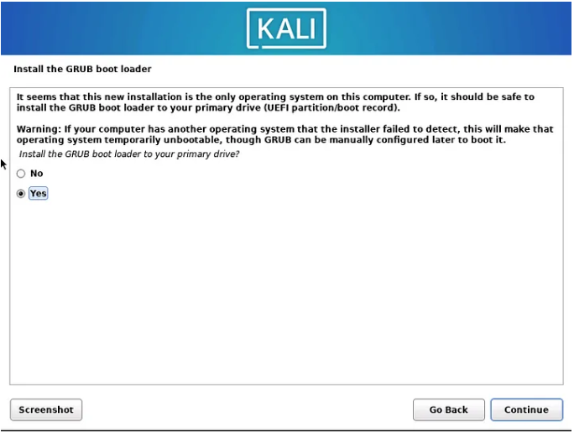
Setting up Kali in VMware
At this stage, let’s proceed by installing the GRUB bootloader. Simply click ‘Yes’ and continue.
Anindya Sinha
#2101CS632  Practical 1 – PERFORM VARIOUS COMMANDS IN LINUX
‹#›

Slide 25
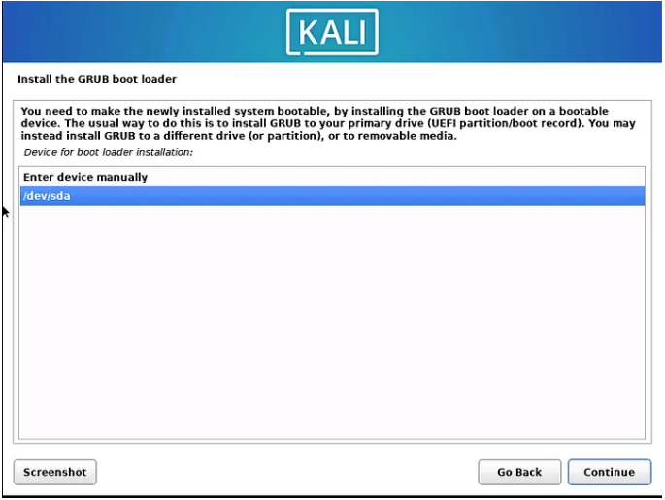
Setting up Kali in VMware
Select your disk and proceed by clicking Continue
Anindya Sinha
#2101CS632  Practical 1 – PERFORM VARIOUS COMMANDS IN LINUX
‹#›

Slide 26
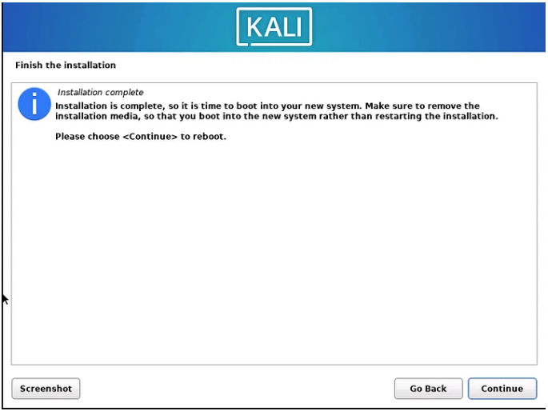
Setting up Kali in VMware
And finally, finish the installation and click on continue to reboot.
Anindya Sinha
#2101CS632  Practical 1 – PERFORM VARIOUS COMMANDS IN LINUX
‹#›

Slide 27

Setting up Kali in VMware
If everything has gone smoothly, you will encounter a screen like this. You can log into the system using the username and password you previously specified in the earlier steps.
Anindya Sinha
#2101CS632  Practical 1 – PERFORM VARIOUS COMMANDS IN LINUX
‹#›

Slide 28
Basic Commands - WHOAMI
Description: Prints the current username.
Example: whoami
Output: Your current username.
Anindya Sinha
#2101CS632  Practical 1 – PERFORM VARIOUS COMMANDS IN LINUX
‹#›

Slide 29
Basic Commands - MAN
Description: Displays the manual for a command.
Example: man ls
Output: Manual pages with information about the "ls" command.
Anindya Sinha
#2101CS632  Practical 1 – PERFORM VARIOUS COMMANDS IN LINUX
‹#›

Slide 30
Basic Commands - CLEAR
Description: Clears the terminal screen.
Example: clear
Output: Clears the terminal screen.
Anindya Sinha
#2101CS632  Practical 1 – PERFORM VARIOUS COMMANDS IN LINUX
‹#›

Slide 31
Basic Commands - PWD
Description: Prints the current working directory.
Example: pwd
Output: The current directory path.
Anindya Sinha
#2101CS632  Practical 1 – PERFORM VARIOUS COMMANDS IN LINUX
‹#›

Slide 32
Basic Commands - LS
Description: Lists files and directories in the current directory.
Example: ls
Output: List of files and directories.
Anindya Sinha
#2101CS632  Practical 1 – PERFORM VARIOUS COMMANDS IN LINUX
‹#›

Slide 33
Basic Commands - CD
Description: Changes the current directory.
Example: cd Documents
Output: Changes to the "Documents" directory.
Anindya Sinha
#2101CS632  Practical 1 – PERFORM VARIOUS COMMANDS IN LINUX
‹#›

Slide 34
Basic Commands - PWD
Description: Prints the current working directory.
Example:pwd
Output: The current directory path.
Anindya Sinha
#2101CS632  Practical 1 – PERFORM VARIOUS COMMANDS IN LINUX
‹#›

Slide 35
Basic Commands - MKDIR
Description: Creates a new directory.
Example: mkdir NewDirectory
Output: Creates a new directory named "NewDirectory."
Anindya Sinha
#2101CS632  Practical 1 – PERFORM VARIOUS COMMANDS IN LINUX
‹#›

Slide 36
Basic Commands - TOUCH
Description: Creates an empty file.
Example: touch newfile.txt
Output: Creates a new empty file named "newfile.txt."
Anindya Sinha
#2101CS632  Practical 1 – PERFORM VARIOUS COMMANDS IN LINUX
‹#›

Slide 37
Basic Commands - RMDIR
Description: Removes an empty directory.
Example: rmdir EmptyDirectory
Output: Removes the empty directory named "EmptyDirectory."
Anindya Sinha
#2101CS632  Practical 1 – PERFORM VARIOUS COMMANDS IN LINUX
‹#›

Slide 38
Basic Commands - RM
Description: Removes files or directories.
Example: rm file.txt
Output: Removes the file named "file.txt."
Anindya Sinha
#2101CS632  Practical 1 – PERFORM VARIOUS COMMANDS IN LINUX
‹#›

Slide 39
Basic Commands - OPEN
Description: Opens a file or directory.
Example: open file.txt
Output: Opens the file "file.txt" with the default application.
Anindya Sinha
#2101CS632  Practical 1 – PERFORM VARIOUS COMMANDS IN LINUX
‹#›

Slide 40
Basic Commands - MV
Description: Moves or renames files and directories.
Example: mv oldfile.txt newfile.txt
Output: Renames "oldfile.txt" to "newfile.txt."
Anindya Sinha
#2101CS632  Practical 1 – PERFORM VARIOUS COMMANDS IN LINUX
‹#›

Slide 41
Basic Commands - CP
Description: Copies files or directories.
Example: cp file.txt backup/
Output: Copies "file.txt" to the "backup" directory.
Anindya Sinha
#2101CS632  Practical 1 – PERFORM VARIOUS COMMANDS IN LINUX
‹#›

Slide 42
Basic Commands - HEAD
Description: Displays the first few lines of a file.
Example: head file.txt
Output: Shows the first few lines of "file.txt."
Anindya Sinha
#2101CS632  Practical 1 – PERFORM VARIOUS COMMANDS IN LINUX
‹#›

Slide 43
Basic Commands - TAIL
Description: Displays the last few lines of a file.
Example: tail file.txt
Output: Shows the last few lines of "file.txt."
Anindya Sinha
#2101CS632  Practical 1 – PERFORM VARIOUS COMMANDS IN LINUX
‹#›

Slide 44
Basic Commands - ECHO
Description: Prints text to the terminal.
Example: echo "Hello, Linux!"
Output: Displays "Hello, Linux!"
Anindya Sinha
#2101CS632  Practical 1 – PERFORM VARIOUS COMMANDS IN LINUX
‹#›

Slide 45
Basic Commands - WC
Description: Counts lines, words, and characters in a file.
Example: wc file.txt
Output: Displays the line, word, and character count of "file.txt."
Anindya Sinha
#2101CS632  Practical 1 – PERFORM VARIOUS COMMANDS IN LINUX
‹#›

Slide 46
Basic Commands - PIPING
Description: Connects the output of one command to the input of another.
Example: ls | grep "keyword"
Output: Lists files and filters results based on the specified keyword.
Anindya Sinha
#2101CS632  Practical 1 – PERFORM VARIOUS COMMANDS IN LINUX
‹#›

Slide 47
Basic Commands - SORT
Description: Sorts lines of text files.
Example: sort file.txt
Output: Displays sorted lines of "file.txt."
Anindya Sinha
#2101CS632  Practical 1 – PERFORM VARIOUS COMMANDS IN LINUX
‹#›

Slide 48
Basic Commands - UNIQ
Description: Filters out adjacent duplicate lines in a file.
Example: sort file.txt | uniq
Output: Displays unique lines from sorted "file.txt."
Anindya Sinha
#2101CS632  Practical 1 – PERFORM VARIOUS COMMANDS IN LINUX
‹#›

Slide 49
Basic Commands - FIND
Description: Searches for files and directories.
Example: find /home/user -name "*.txt"
Output: Finds all files with the ".txt" extension in the specified directory.
Anindya Sinha
#2101CS632  Practical 1 – PERFORM VARIOUS COMMANDS IN LINUX
‹#›

Slide 50
Basic Commands - GREP
Description: Searches for patterns in files.
Example: grep "pattern" file.txt
Output: Displays lines containing the specified "pattern" in "file.txt."
Anindya Sinha
#2101CS632  Practical 1 – PERFORM VARIOUS COMMANDS IN LINUX
‹#›

Slide 51
Basic Commands - NANO
Description: Text editor for editing files in the terminal.
Example: nano file.txt
Output: Opens "file.txt" for editing in the nano text editor.
Anindya Sinha
#2101CS632  Practical 1 – PERFORM VARIOUS COMMANDS IN LINUX
‹#›

Slide 52
Basic Commands - SU
Description: Switches user or superuser.
Example: su username
Output: Switches to the specified user.
Anindya Sinha
#2101CS632  Practical 1 – PERFORM VARIOUS COMMANDS IN LINUX
‹#›

Slide 53
Basic Commands - SU
Description: Sets or modifies file permissions.
Example: chmod +x script.sh
Output: Grants execute permission to "script.sh."
chmod
Description: Changes file permissions.
Example: chmod 755 file.txt
Output: Sets read, write, and execute permissions for the owner, and read and execute permissions for the group and others.
Anindya Sinha
#2101CS632  Practical 1 – PERFORM VARIOUS COMMANDS IN LINUX
‹#›

Slide 54
Basic Commands - MAN
Description: Displays the manual for a command.
Example: man command
Output: Manual pages with information about the specified command.
Anindya Sinha
#2101CS632  Practical 1 – PERFORM VARIOUS COMMANDS IN LINUX
‹#›

Slide 55
I came I saw I conquered

